Slide 1
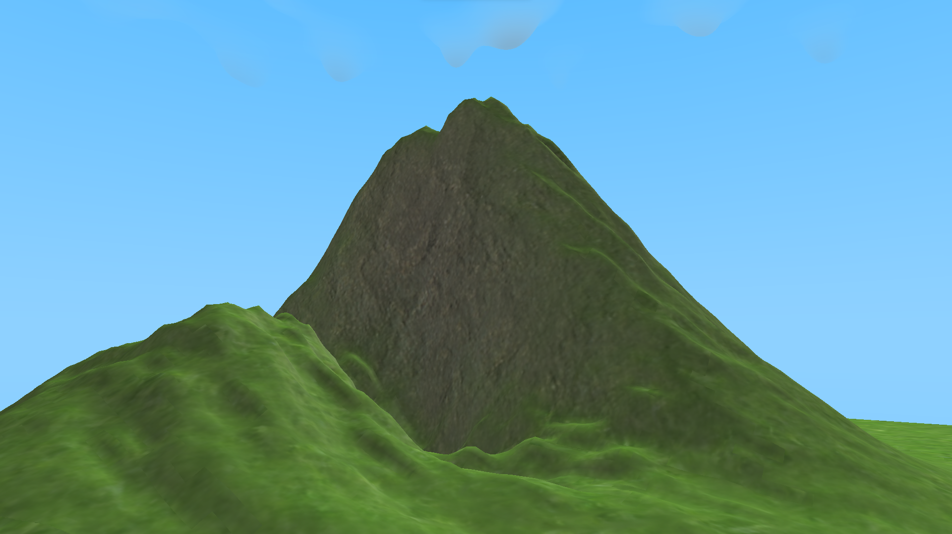
Pycraft
Play
Credits
Settings
Achievements
Character Customisation

Slide 2
Pycraft
Play
Credits
Settings
Achievements
Character Customisation

Slide 3

Pycraft
Play
Credits
Settings
Achievements
Character Customisation

Slide 4
Pycraft
Play
Credits
Settings
Achievements
Character Customisation

Slide 5

Pycraft

Slide 6



Slide 7

Pycraft

Slide 8

Pycraft

Slide 9
Pycraft

Slide 10


Slide 11


Slide 12

#
PycraftDev

Slide 13
#
PycraftDev

Slide 14


Slide 15
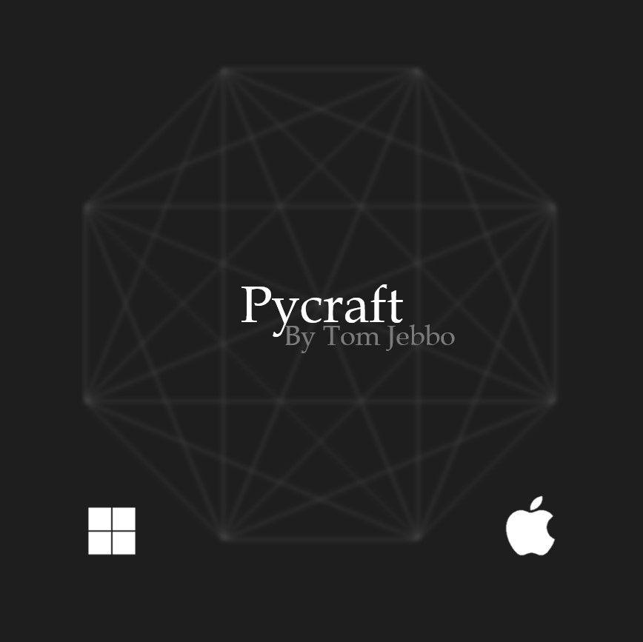

Slide 16
Pycraft
By PycraftDev

Slide 17



Slide 18


Slide 19

P

Slide 20

Pycraft

Slide 22


